Slide 1


User Manual for CASA Account Opening

Slide 2
Scope of work :
1. CASA Opening, Maintenance and Closing
2. FDR Opening, Maintenance and Closing
3. Cheque( CBRMS functions)
4. Cards ( all types)
5. Locker Opening, Maintenance and Closing
6. Sanchaypatra/BOND Opening and Closing
7. ADC Service
8. NRB/ Remittance
9. Fund Transfer( BFTN,RTGS, Salary)
10. Credit Card Cheque Processing

Slide 3
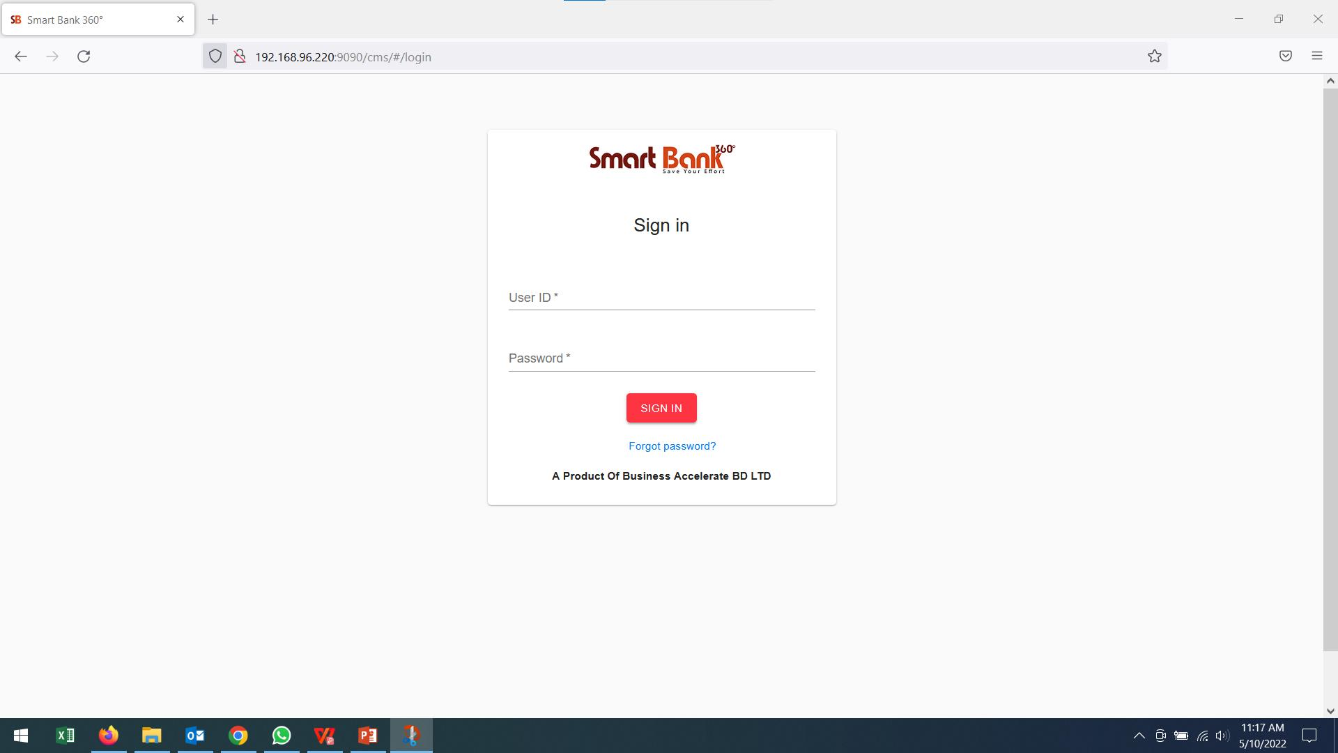
LOG IN PAGE

Slide 4
CASA Opening (Account opening: Individual and Joint)
A. Individual and joint( Regular and Instant pack, NTB or ETB, with mandate or with beneficiary
owner or both) a long with other Services , Cheque Book, Instant Debit Card)
1. Dedupe
2. SDN
3. NID Verification
CASA Opening (Account opening: Individual and Joint along with others Regular and Insta pack Services)
Note: We have the two options for DEDUPP and SD checking by using Information or
if we know the CB we can use existing CB , when we use Existing CS, only
conventional option will be appear ,
DEDUPE Checking with Mandatory Data for Single Account

Slide 5
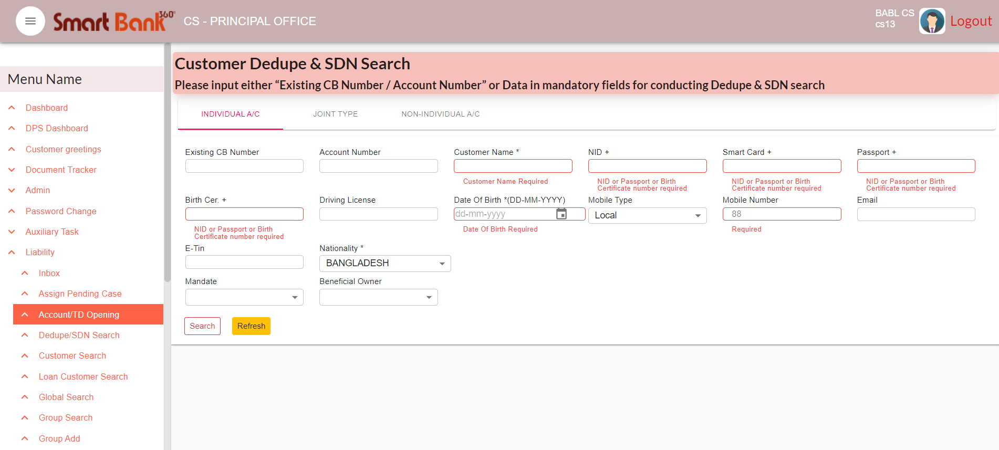
CASA AC Opening (NTB)
Here user will conduct deduplication before any AC open.
User must input mandatory fields during the dedupe.
Click on Search button to show the result

Slide 6
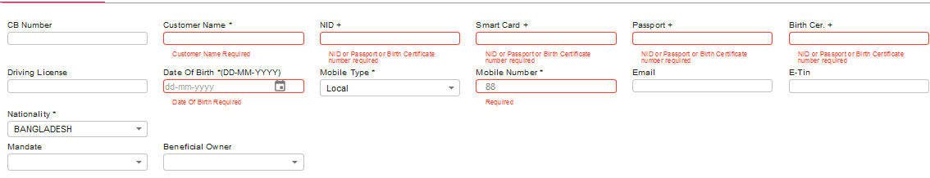
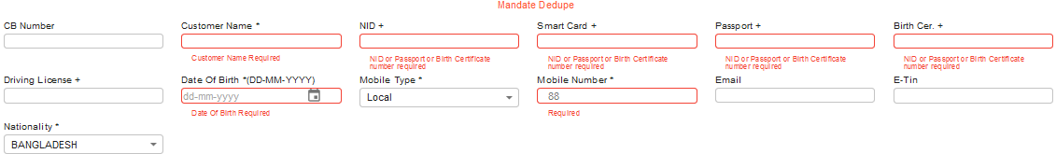
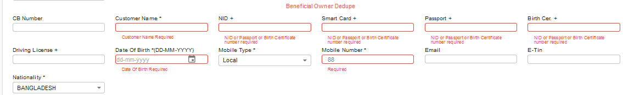
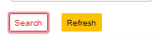
DEDUPE Checking with Mandatory Data for Single Account with mandate & Beneficial Owner

Slide 7
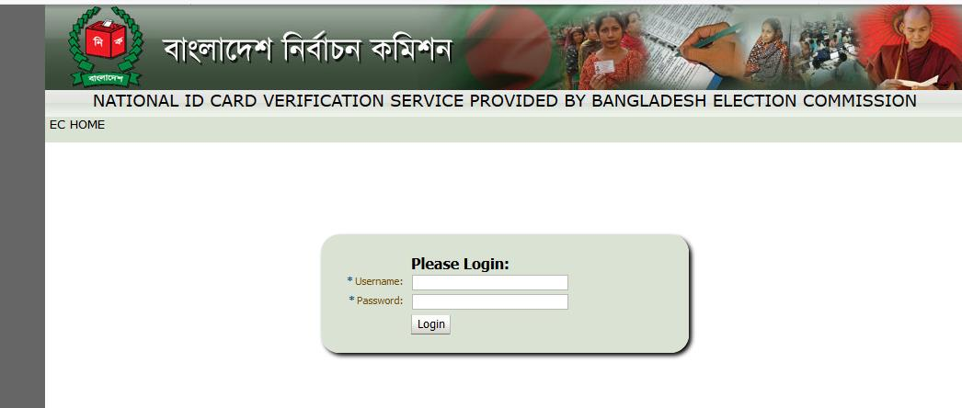
Note: For De-dupe and SDN result no need to download or Print the result it will
automatically forward to BOM and SD end consequently.
NID Verification Process and Download PDF
Click the NID check link

Slide 8
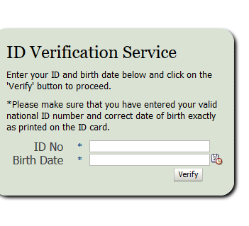
Process of converting NID copy to PDF format

Slide 9
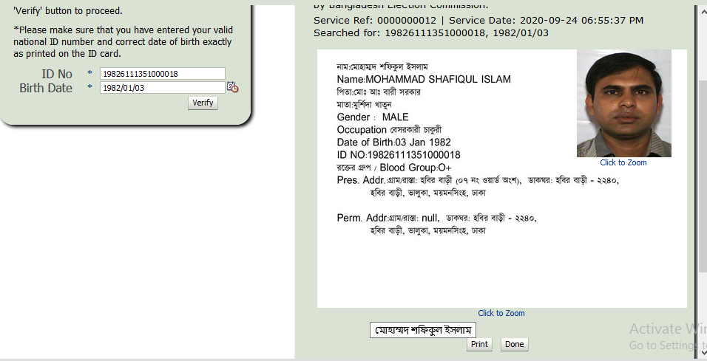
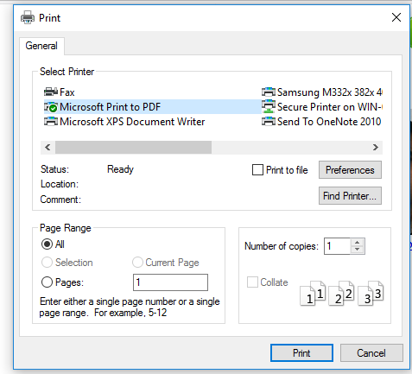
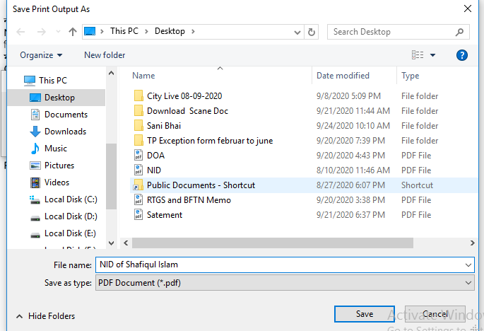
Note: Save the same in require folder

Slide 10
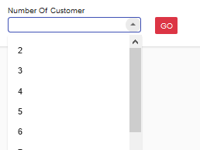
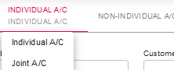
Account opening Joint
Mandatory Field for De-Dupe for Joint Account

Slide 11
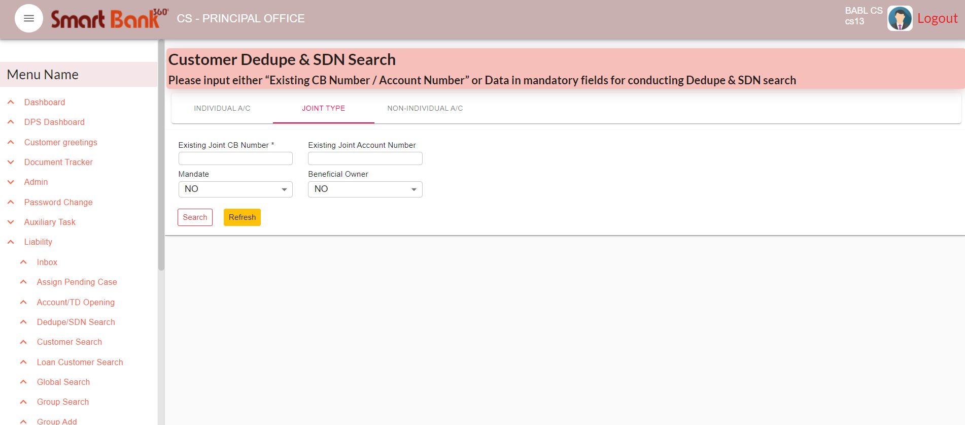

Slide 12
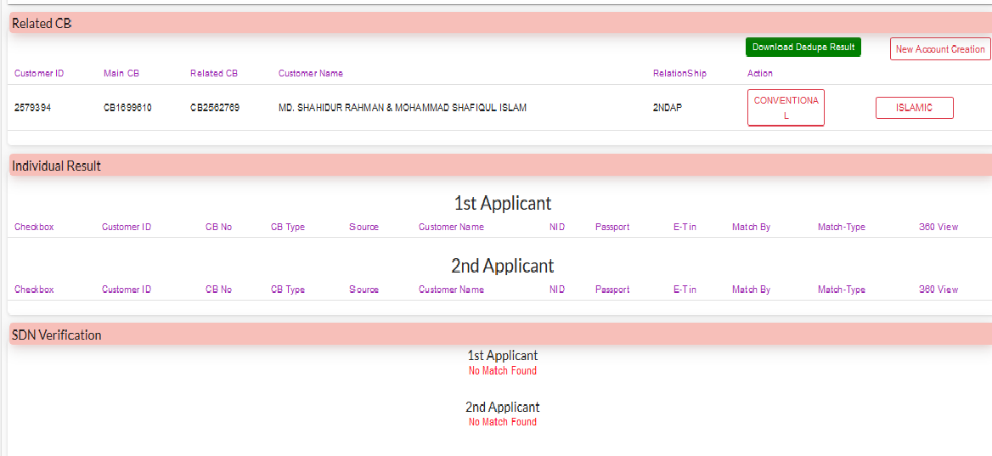
De-Dupe Result
Note: NID Verification as per previously mentioned process.

Slide 13
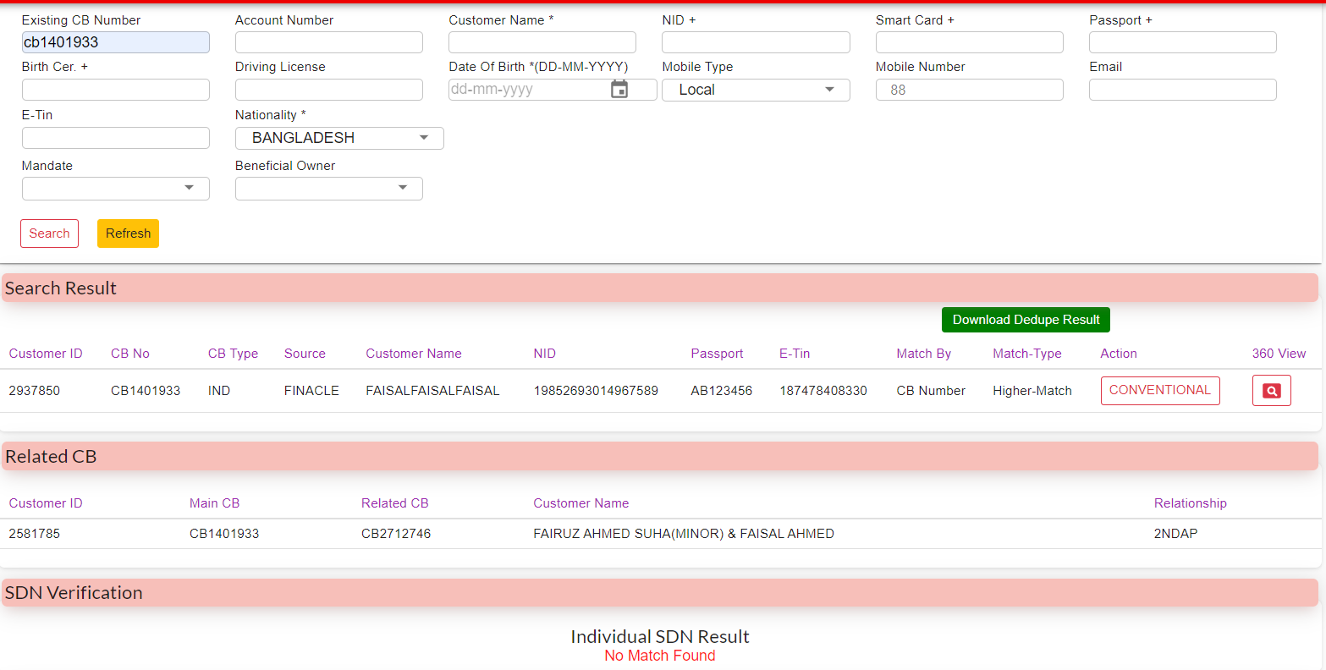
CASA AC Opening (NTB)
After conducting dedupe individual Customer result, SDN, NID verification will show here.
Based on the search result user will chose new AC/Existing AC open button.

Slide 14
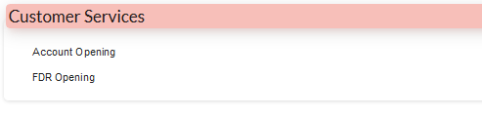
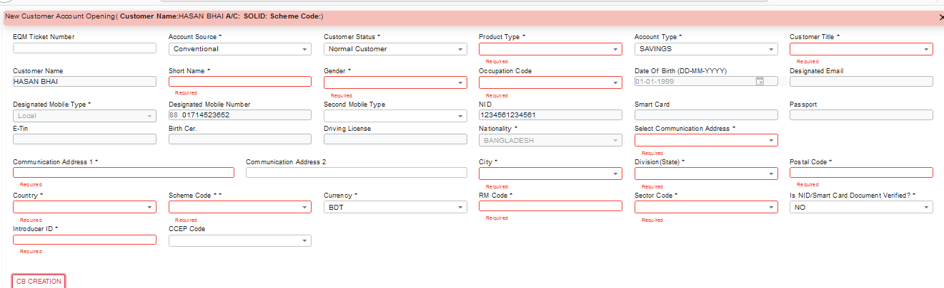
New Two (02) steps for Regular Account opening We have to follow step by step as follows after DEDUPE and SDN Checking.
CB Creation
Red marked field is mandatory

Slide 15
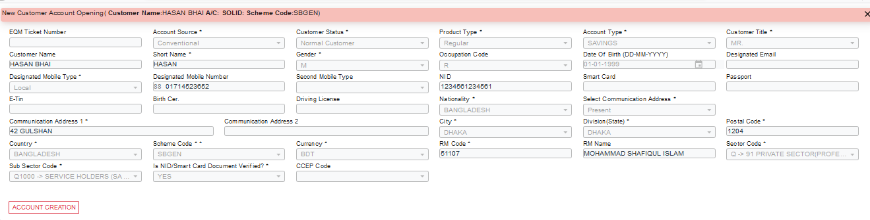
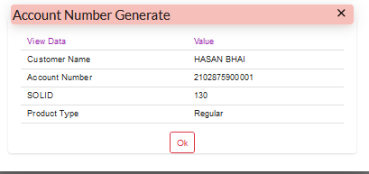

Account Creation

Slide 16
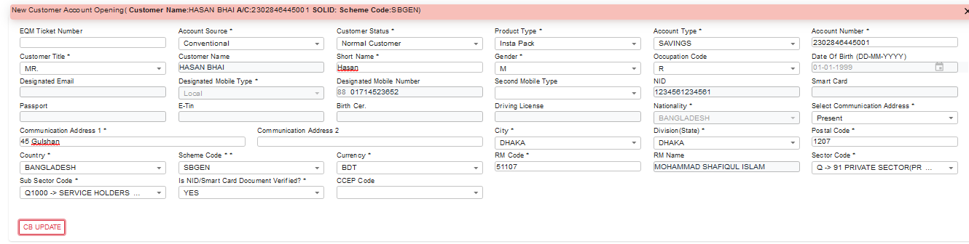
New (03) steps for Insta Pack Account opening.
We have to follow step by step as follows after DEDUPE and SDN Checking.
CB Creation

Slide 17
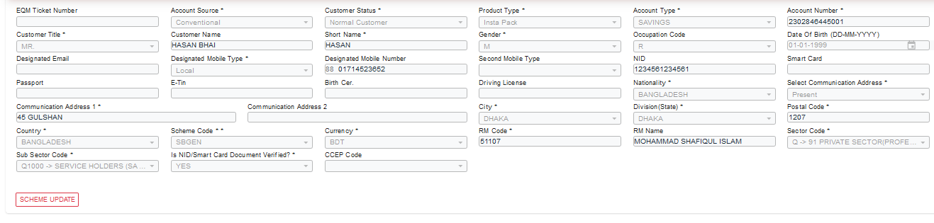
Account Creation
Scheme Update

Slide 18
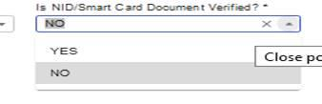
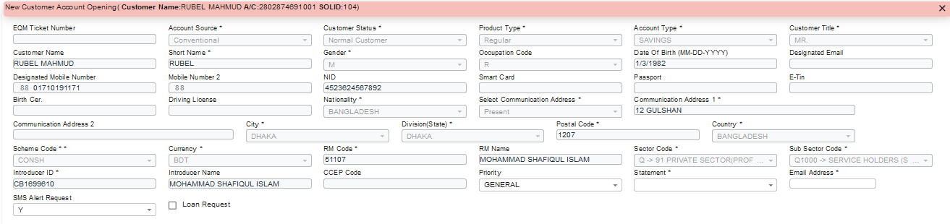
NID verification Yes/No, you have to select
Note: If NID verification select yes no need to introducer, Others procedure remain same.
Others facilities along with AOF opening

Slide 19
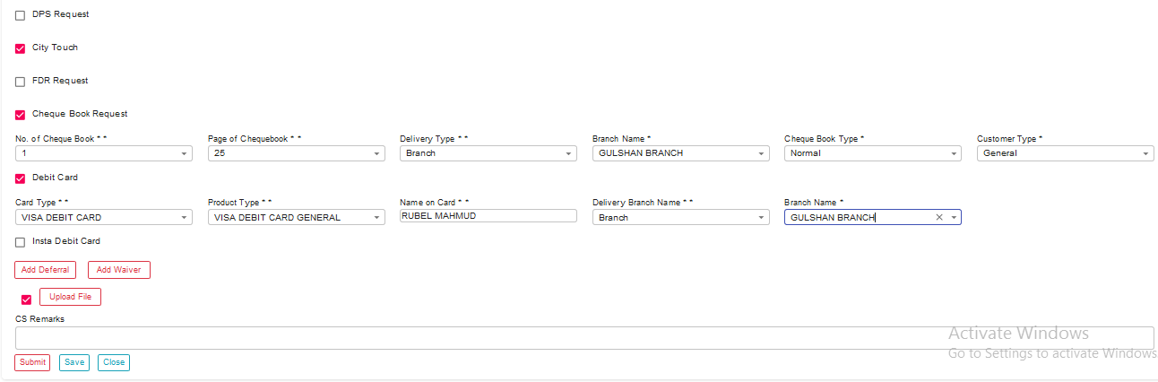
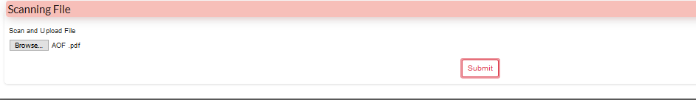
Note: To ensure Scan all AOF first (black and white) then need to Scan Signature card (Color) and preserve
all document in the same folder where NID already belong. Fist upload all AOF, 2nd NID then Signature Card,
Delete and replacement of uploaded file facilities are available.

Slide 20
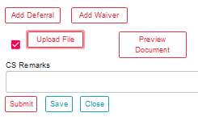

After confirmation, request forward to BOM End

Slide 21
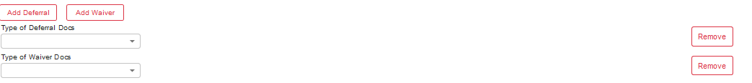
In case of Deferral and waiver CS group raise the request through LWF to BM as per
CBL policy. After accomplishment of Deferral and Waiver then CS send the request
to BOM.

Slide 22
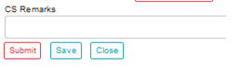
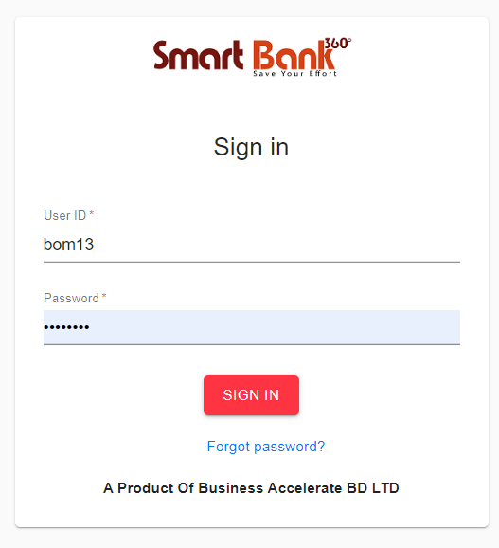
Note: If raise the deferral and waiver request it automatically forward to BM
BOM Part

Slide 23
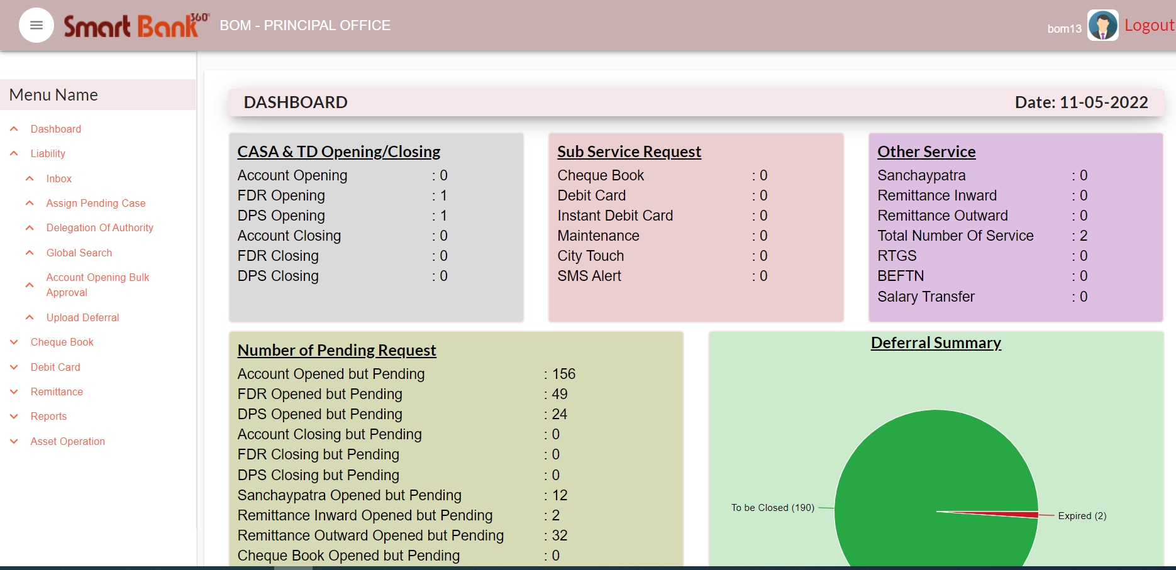
A. Group Inbox show the all Pending requests at BOM end
B. Self-Inbox shows only Locked items by BOM
C. Corrected Request shows Return items after CS correction
D. Submit shows after approve/return items from BOM
E. Complete shows after final completed items by end user
F. User can use various Searcher options to select the items from queue
G. User also can check status of the items in Global Search

Slide 24
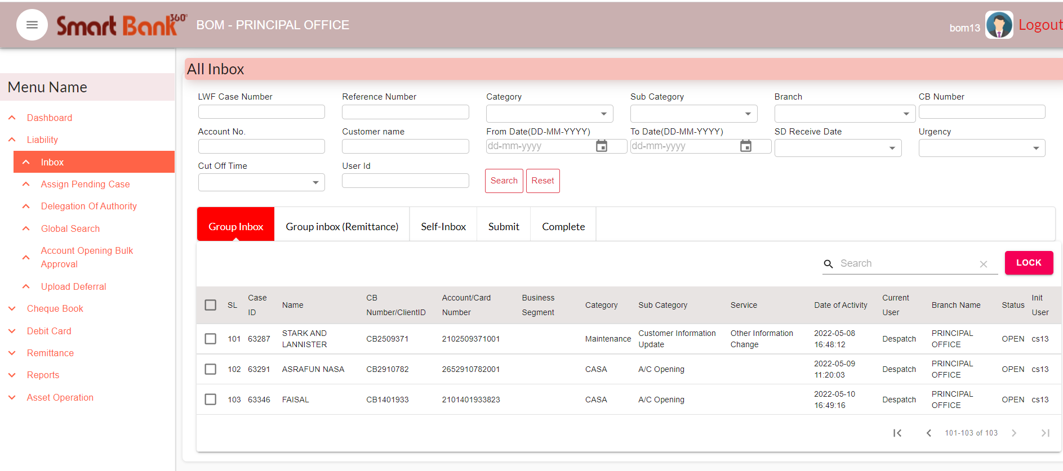
BOM will able to view all CS inputted data along with documents in split window where Customer
Signature Card, Debit Account Statement, Preview Documents, Back & forth Remarks Details, De
dupe/SDN Result, Deferral / Waiver Status (if any), Approve and Return with Remarks options are
available to check.
Case will be populate on Group Inbox. Every user case see.

Slide 25
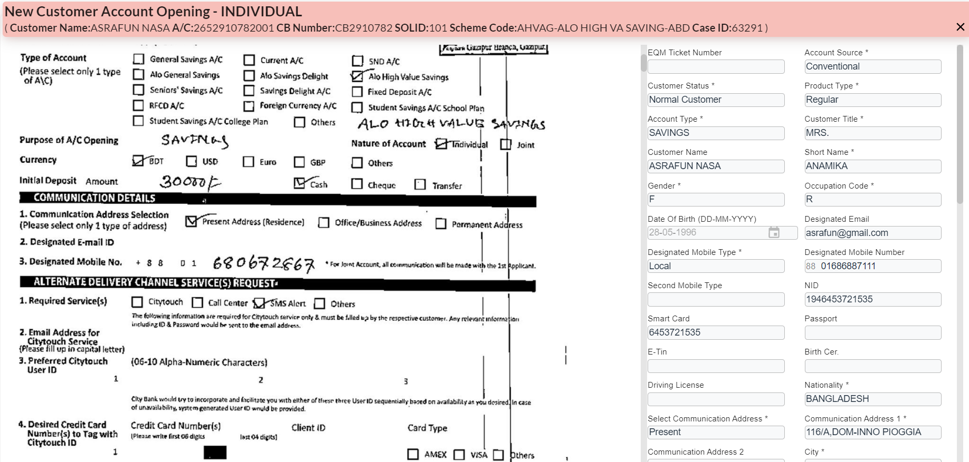
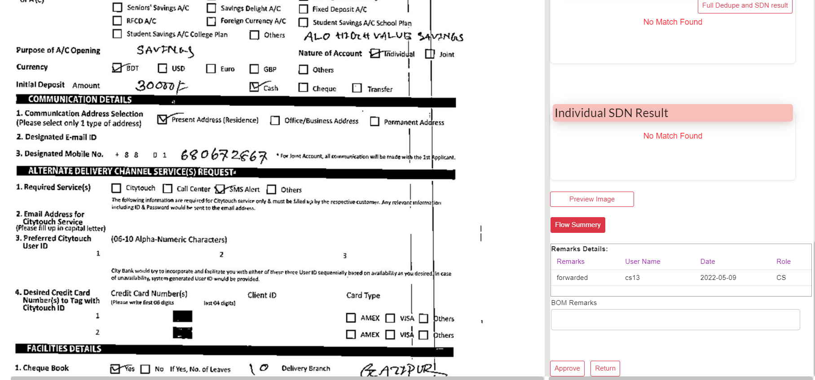
Case will be populate on Group Inbox. Every user case see.
Click on the Case which wants to process.
BOM can Approve or Return case.
If BOM Return any case it should be go to the CS’s ‘Return Inbox’
After BOM verification case will be go on Maker’s ‘Group Inbox’

Slide 26
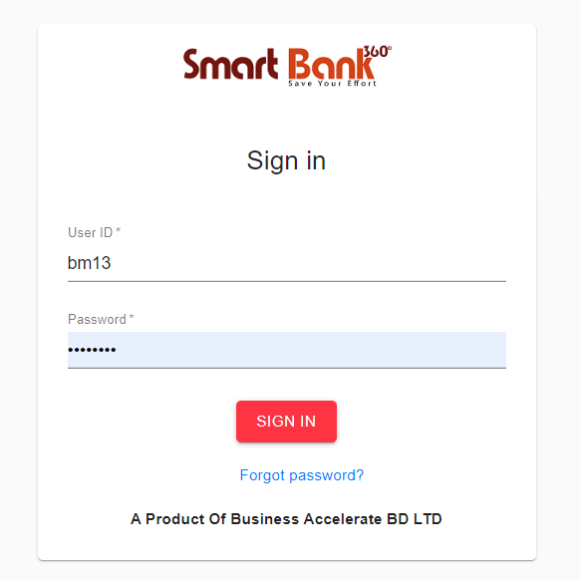
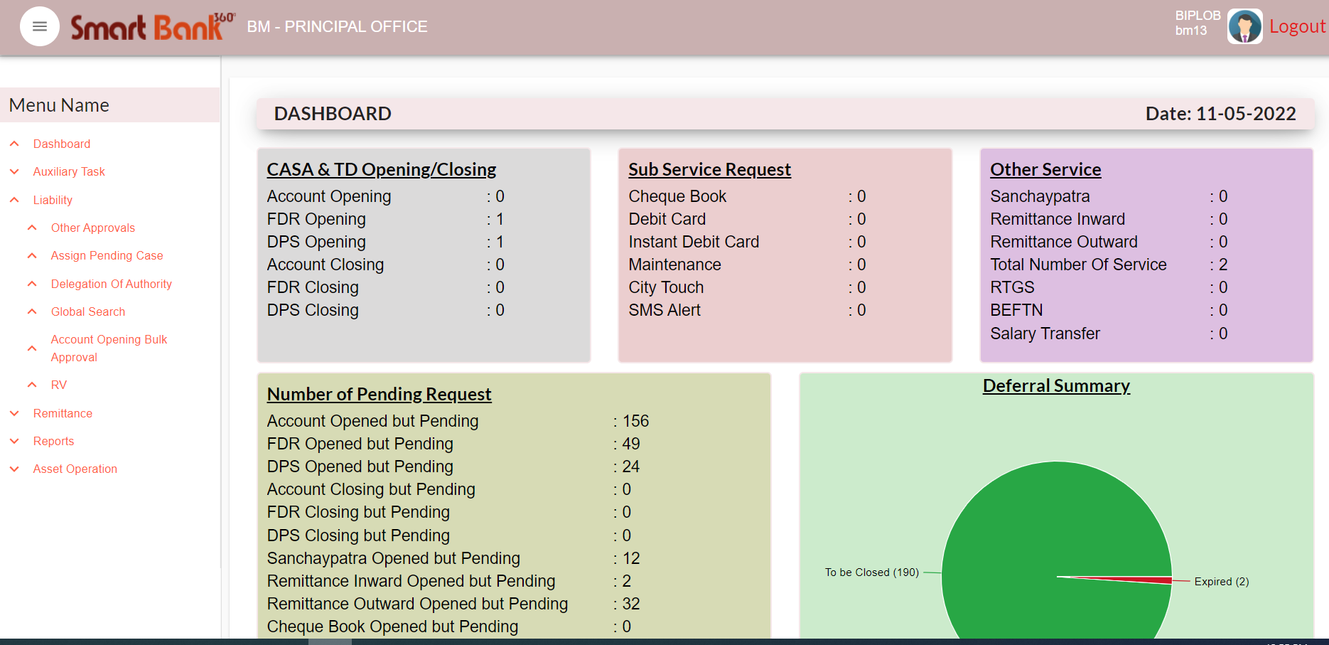
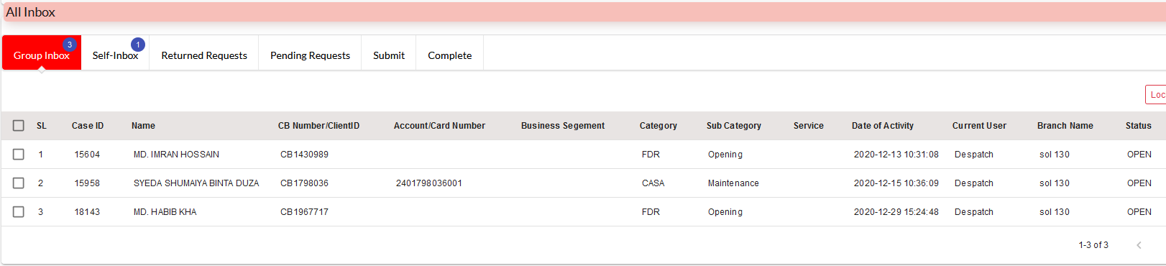
BM Part
Login with User ID & Password
1. Others/Single Approval
2. Bulk Approval

Slide 27
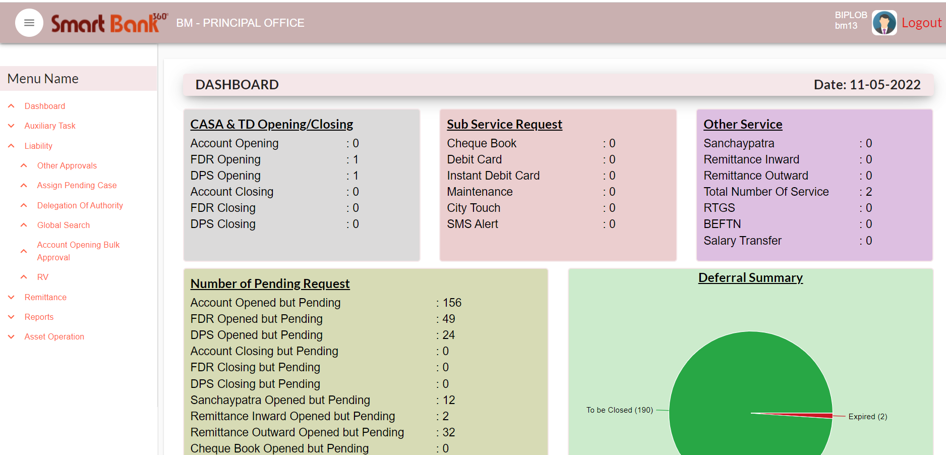
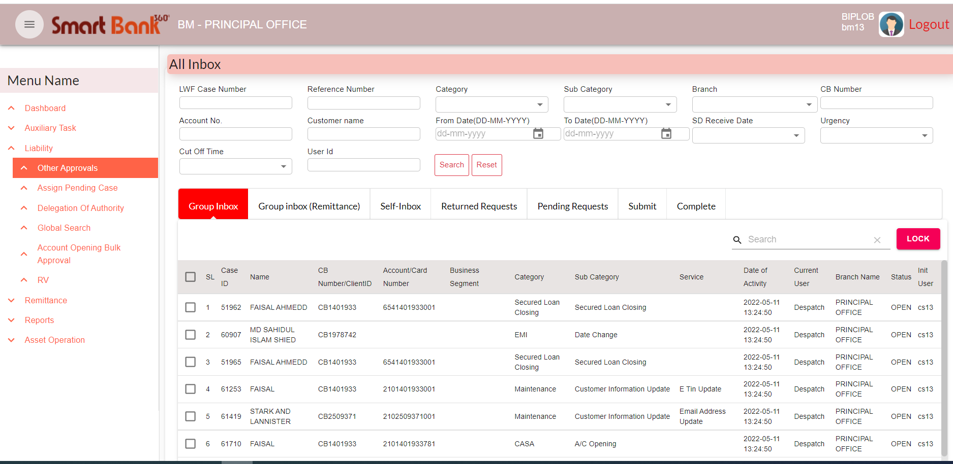
Other Approval/Single Approval.
Account Opening Bulk Approval
All request are goes to ‘Group Inbox’ (With Deferral)
Click on the case which is wants to process it will be open it will be ‘Locked’

Slide 28
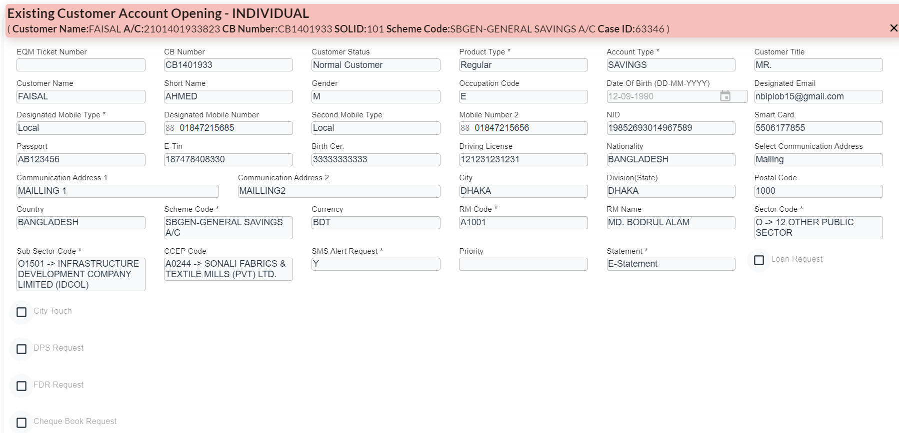
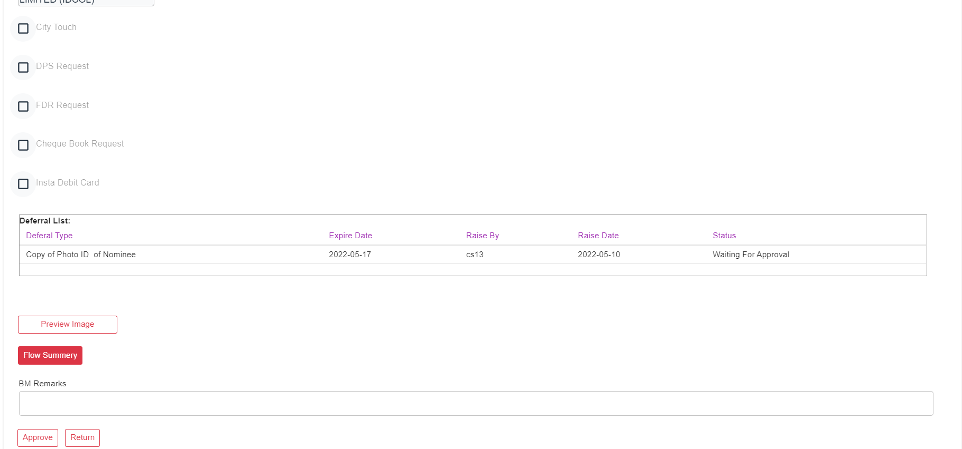
BM view
BM user can Approve or Return any case.
If wants to Return any case, BM Remarks should be mandatory.
If case Return it will go CS user’s Return Inbox.
If BM user Approve the case, it will be goes to the BOM user.

Slide 29
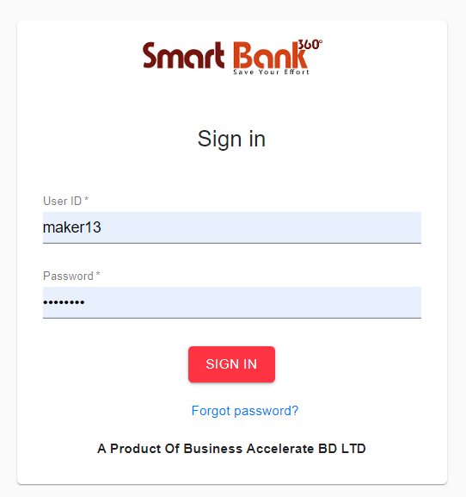
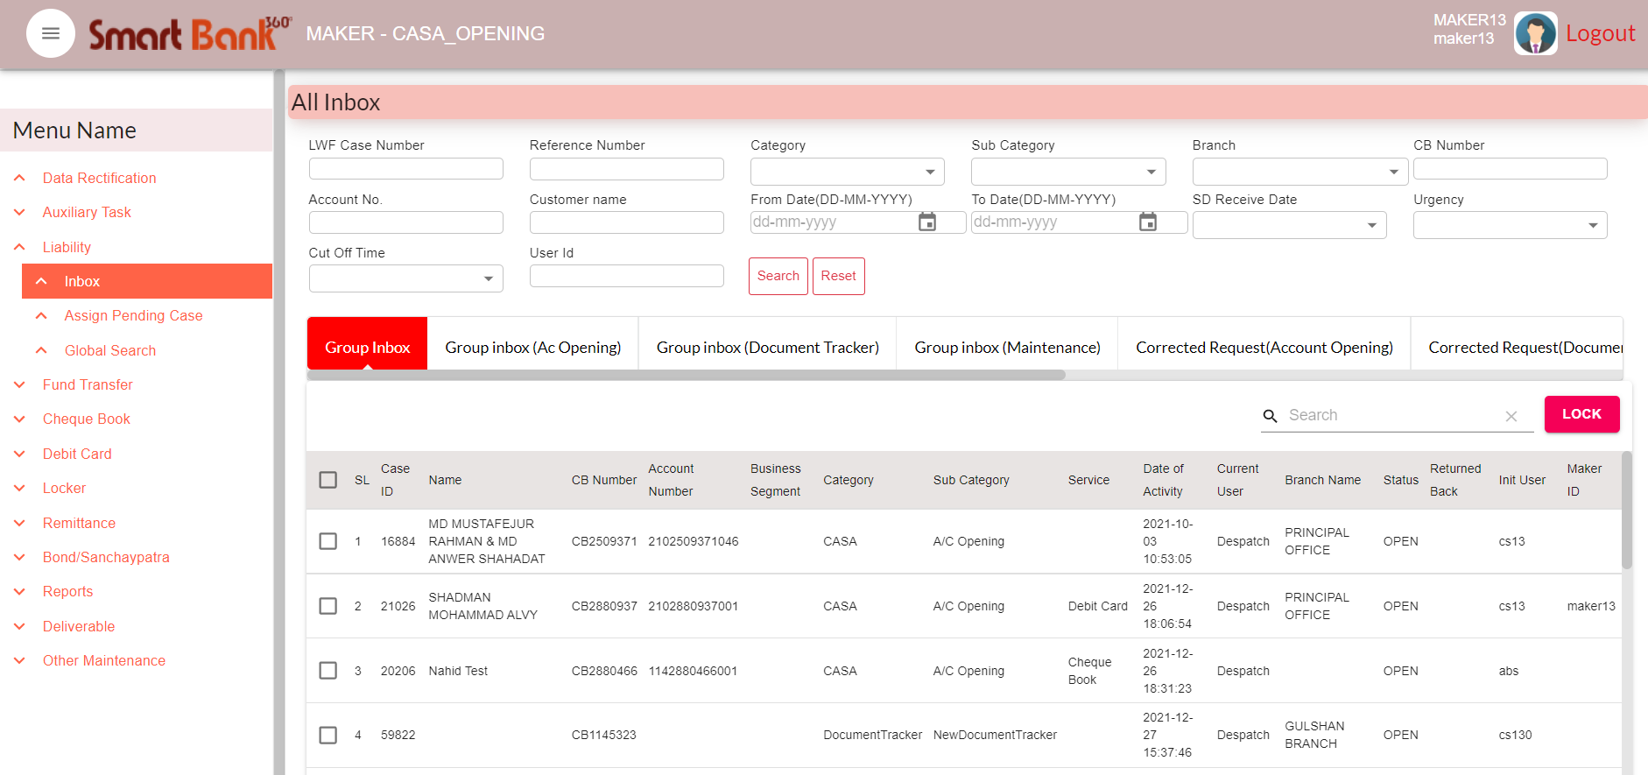
SD Maker Part
Provide the User ID & Password

Slide 30
A. Group Inbox show the all Pending requests at SD Maker end
B. Self-Inbox shows only Locked items by SD Maker
C. Return Request shows Return items from SD Checker
D. Corrected Request shows Return items after CS correction
E. Pending Request shows only Save items by SD Maker
F. SD Pending Case shows Shadow items where other unit’s dependencies remaining
G. Submit shows after Submit/Return items from SD Maker
H. Complete shows after final completed items by end user
I. User can use various Searcher options to select the items from queue
J. User also can check status of the items in Global Search

Slide 31
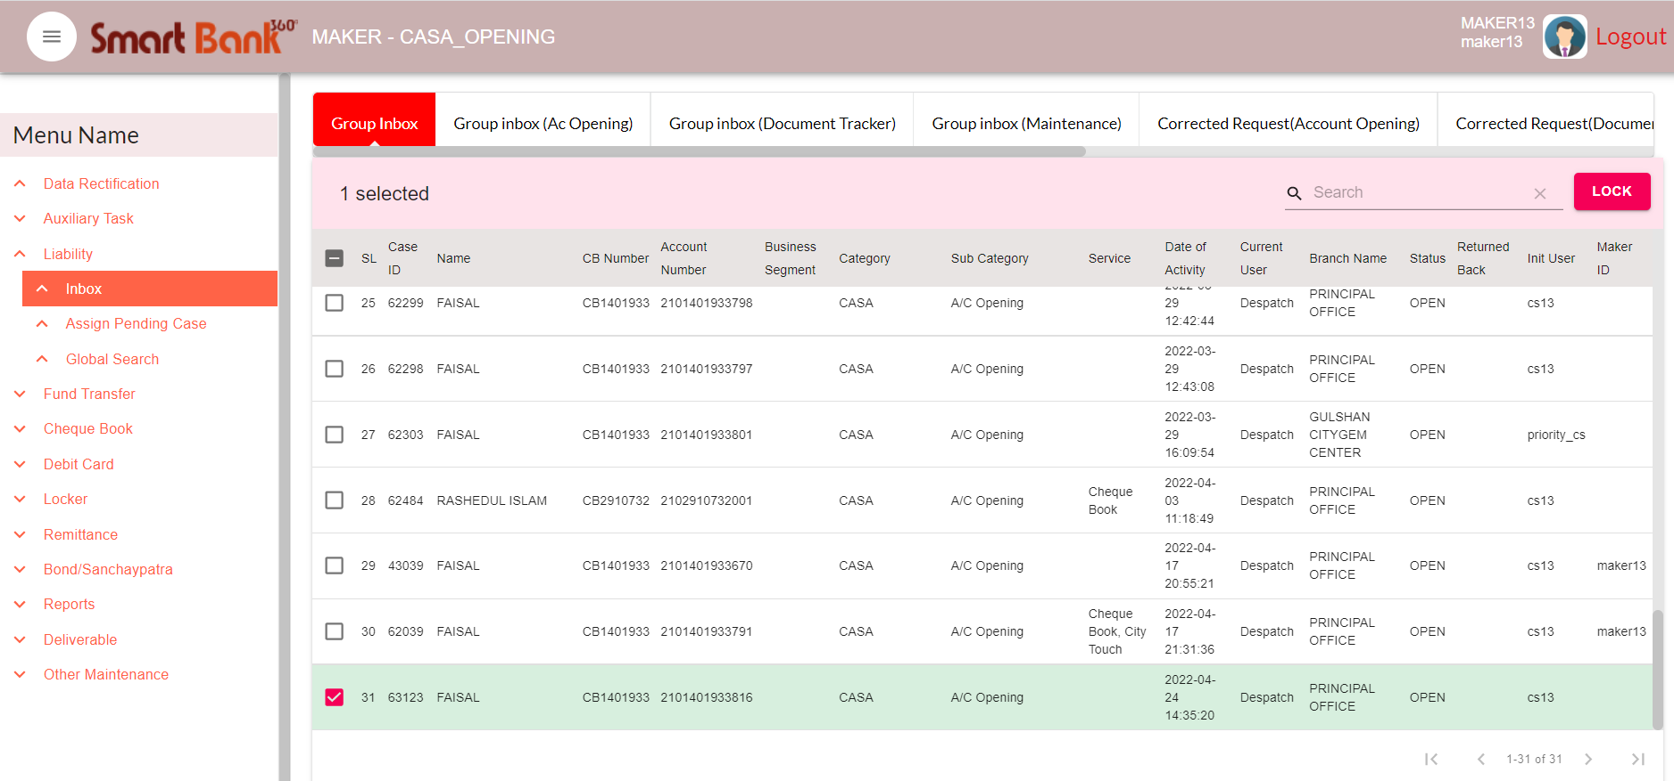
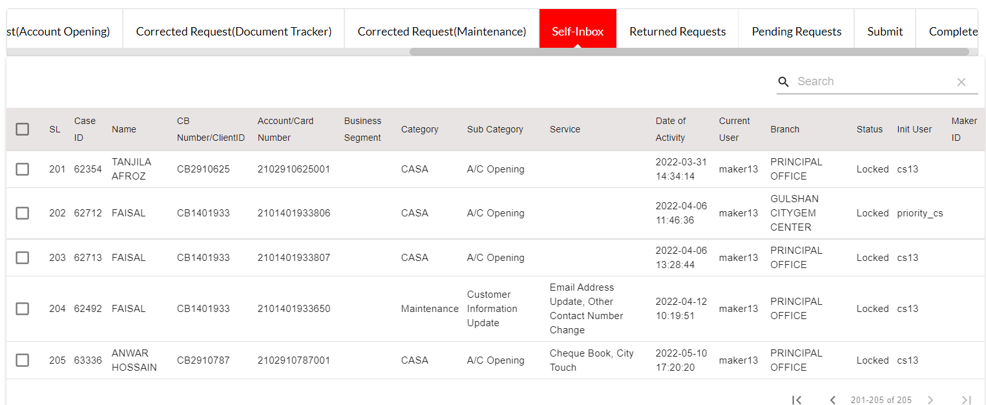
All case will be goes to the ‘Group Inbox’
Which case wants to process, select the case & click on ‘Lock’. It will goes to the ‘Self Inbox’
Case can process from ‘Self Inbox’

Slide 32
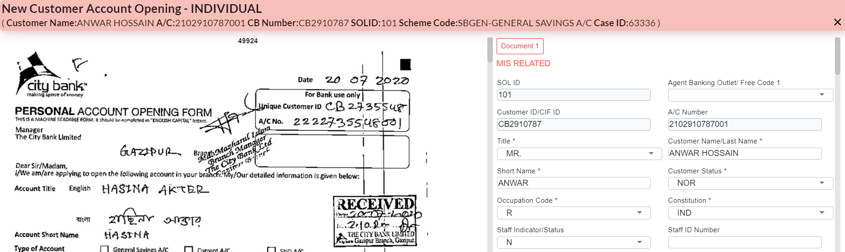
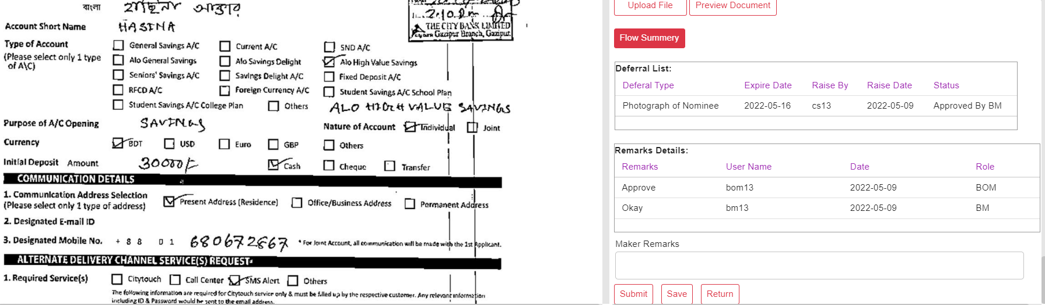
Maker can Submit, Save or Return the case.
If Return the case it will goes to ‘CS’s Return Inbox’. Remarks should be mandatory.
After ‘Submit’ it will goes to ‘Checker

Slide 33
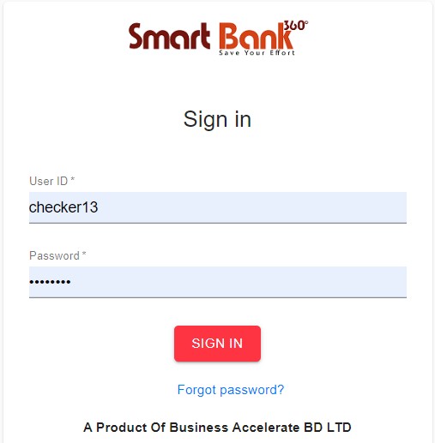
SD Checker Part
Login with User ID & Password

Slide 34
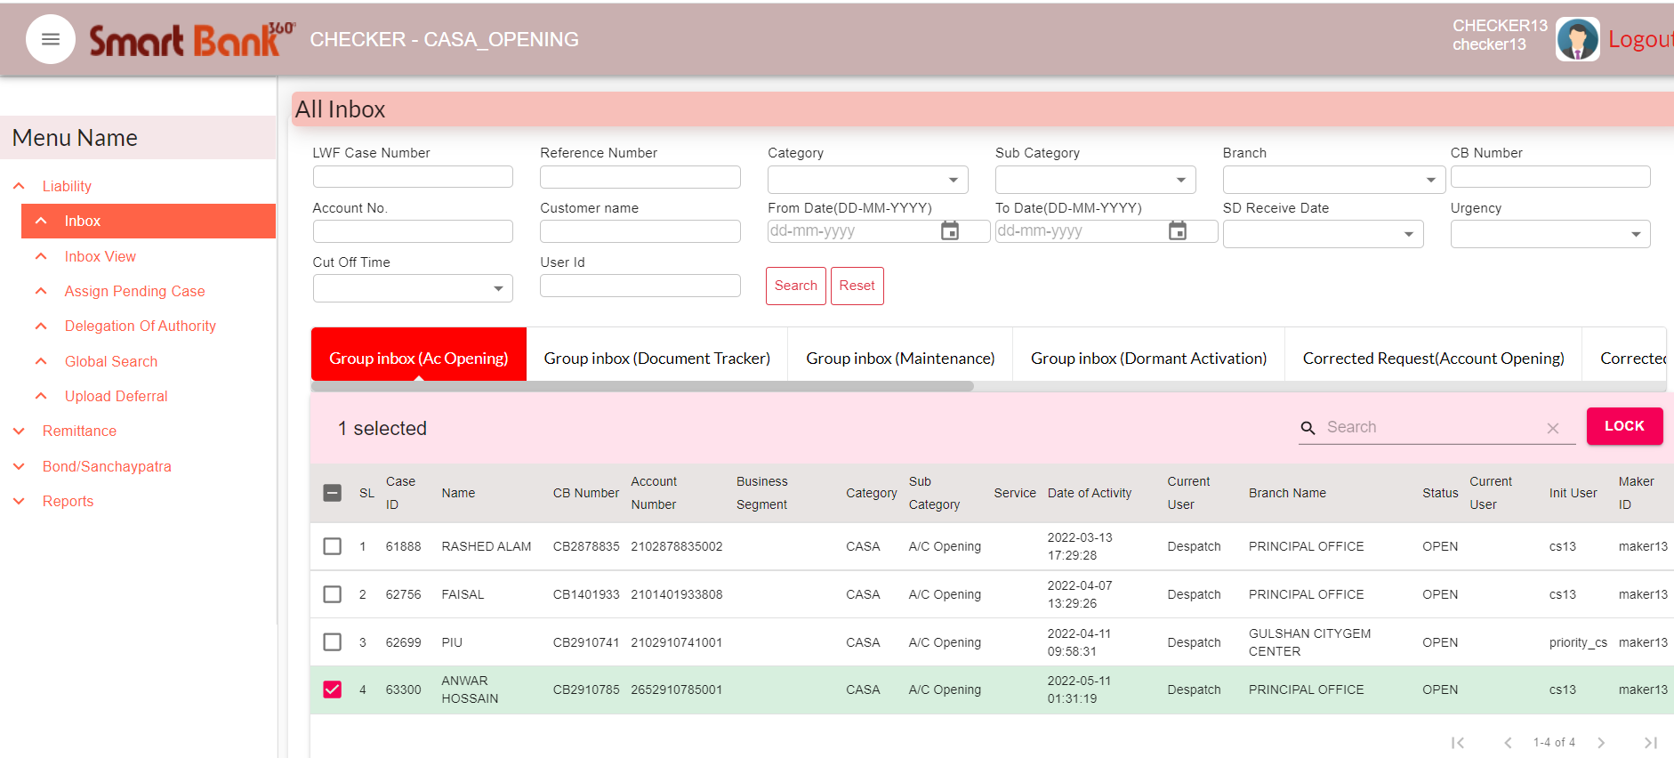
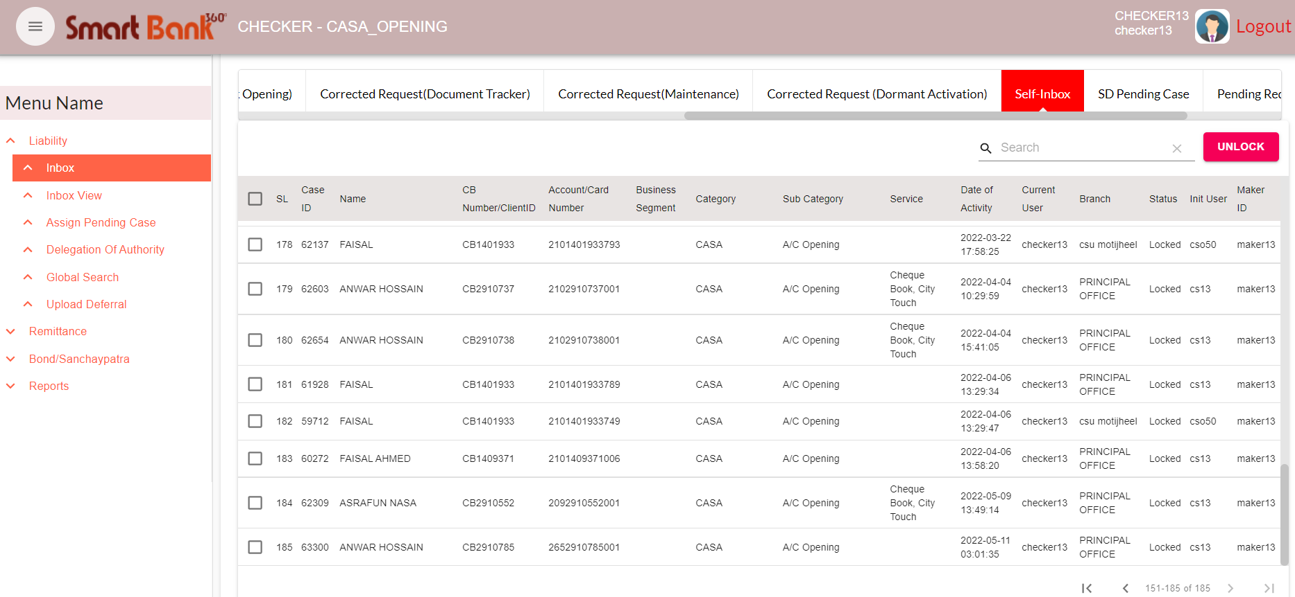
All case will be goes to the ‘Group Inbox’
Which case wants to process, select the case & click on ‘Lock’. It will goes to the ‘Self Inbox’
Case can process from ‘Self Inbox’

Slide 35


Checker can Submit, Save or Return the case.
Checker can Return any case to the CS user and Maker user. Case will goes to ‘Return Inbox’ Remarks should be mandatory.
After Checker’s verification, case will be completed.

Slide 36
The End

